Slide 1
Unit 14 Security and Integrity

Slide 2
Contents
14.1 Introduction
14.2 Security
14.3 Integrity
14.4 Security and Integrity in INGRES
14.5 Security in Statistical Databases
14.6 Data Encryption
user
DBMS
user
File
Manager
O.S.
DB

Slide 3
14.1 Introduction

Slide 4
Security and Integrity
Objective
Security: protect data against unauthorized disclosure, alteration, or destruction.
Integrity: ensure data valid or accurate.
Problem
Security: allowed or not ?
Integrity: correct or not ?
Similarity between Security and Integrity
the system needs to be aware of certain constraints that the users must not violate.
constraints must be specified (by DBA) in some languages.
constraints must be maintained in the system catalog (or dictionary).
DBMS must monitor user interactions.

Slide 5
14.2 Security

Slide 6
General Considerations
Aspects of the security problem:
Legal, social, ethical
Physical control
O.S. security
DBMS
The unit of data for security purpose
an entire database
a relation
a specific row-and-column data
Access Control Matrix
A given user typically have different access rights on different objects.
Different users may have different access rights on the same object.
Access right on object: read, write, owner, …
S.S# S.Status S. ... P SP
1 1 1 ... 0 0
.. …. ….. . ..
Charley

Slide 7
Security on SQL: View Mechanism
Two features
View mechanism: hide sensitive data.
Authorization subsystem: specify access right.
View Mechanism
<e.g.1> For a user permitted access only supplier records located in Paris :
CREATE VIEW PARIS_SUPPLIERS
AS SELECT S#, SNAME, STATUS, CITY
FROM S
WHERE city = 'Paris'; /*value dependent*/
Users of this view see a horizontal subset, similar views can be created for vertical subset or row-and-column subset.
<e.g.2> For a user permitted access to catalog entries for tables created by that user:
CREATE VIEW MY_TABLES
AS SELECT *
FROM SYSTABLE
WHERE CREATOR = USER; /*context dependent*/
Table View

Slide 8
Security on SQL (cont.)
<e.g.3> For a user permitted access to average shipment quantities per supplier, but not to any individual quantities :
CREATE VIEW AVQ ( S#, AVGQTY )
AS SELECT S# , AVG(QTY)
FROM SP
GROUP BY S#; /*statistical summary*/
Advantages of view mechanism
Provide security for free.
many authorization checks can be applied at compile time.

Slide 9
Security on SQL: Authorization Subsystem
In DB2, the installation procedure
specify a privilege user as the system administrator.
the system administrator is given a special authority SYSADM, means the holder can perform every operation the system support.
the system administrator grant rights to other user.
use access control matrix
<e.g.1> [GRANT]
GRANT SELECT ON TABLE S TO CHARLEY;
GRANT SELECT, UPDATE ( STATUS, CITY ) ON TABLE S TO JUDY, JACK, JOHN;
GRANT ALL ON TABLE S, P, SP TO FRED, MARY;
GRANT SELECT ON TABLE P TO PUBLIC;
GRANT INDEX ON TABLE S TO PHIL;
<e.g.2> [REVOKE]
REVOKE SELECT ON TABLE S FROM CHARLEY;
REVOKE UPDATE ON TABLE S FROM JOHN;
REVOKE INSERT, DELETE ON TABLE SP FROM NANCY, JACK;
REVOKE ALL ON TABLE S, P, SP FROM SAM
S.S# S.Status S. ... P SP
1 1 1 ... 0 0
.. …. ….. . ..
Charley

Slide 10
Security on SQL: Authorization Subsystem
The rights that apply to tables (both base tables and views):
SELECT
UPDATE: can specify column
DELETE
INSERT
The rights that apply to base tables only
ALTER: right to execute ALTER TABLE
INDEX: right to execute CREATE INDEX
The GRANT option
User U1: GRANT SELECT ON TABLE S TO U2 WITH GRANT OPTION;
User U2: GRANT SELECT ON TABLE S TO U3 WITH GRANT OPTION;
User U3: GRANT SELECT ON TABLE S TO U4 WITH GRANT OPTION;
The REVOKE will cascade
User U1: REVOKE SELECT ON TABLE S FROM U2;
U3, U4, are revoked automatically!
Authorization can be queried (recorded in system catalog).

Slide 11
Aspects of Security
Other Aspects of Security
The total system should be secure.
Not to assume the security system is perfect
Audit Trail: keep track of all operations' information.
<e.g.> terminal, user, date, time, ...
Statistical Databases: 14.5
Data Encryption: 14.6
Access Control Schemes (papers)
user
DBMS
user
File
Manager
O.S.
DB

Slide 12
14.3 Integrity

Slide 13
General Considerations of Integrity
“Integrity" refers to accuracy or correctness.
Most of integrity checking today is still done by user-written procedure.
It is preferable to specify integrity constraints in declarative fashion and have the system to do the check.
Integrity constraint can be regarded as a condition that all correct states of the database required to satisfy.
<e.g.> FORALL SX ( SX.STATUS > 0 )
If an integrity constraint is violated, either
<1> Reject, or
<2> Perform compensating action to ensure the correctness.
Language for specifying integrity constraints should include
<1> the ability to specify arbitrary conditions.
<2> the ability to specify compensating actions.
CREATE INTEGRITY RULE R1
ON INSERT S.STATUS,
UPDATE S.STATUS;
CHECK FORALL S ( S.STATUS > 0 )
ELSE REJECT;

Slide 14
Types of Integrity Constraints
Domain Constraints
values of an attribute are required to belong to a pool of legal values (domain).
<e.g.> S.STATUS > 0
SP.QTY > 0
Primary and Foreign key constraints
<e.g.> S.S# must be unique
SP.S# must be contained in S.S#.
FD, MVD, JD
<e.g.> S.S# => S.CITY
SX SY ( IF SX.S# = SY.S# THEN SX.CITY = SY.CITY )
Format Constraints
<e.g.> ID number: A999999999
Range Constraints
<e.g.> SALARY in ( 10,000 ~ 100,000 ).

Slide 15
A Hypothetical Integrity Language
Two statements
<1> CREATE INTEGRITY RULE
<2> DROP INTEGRITY RULE
<e.g.1> STATUS values must be positive:
Rule name: R1.
Checking times: ON INSERT S.STATUS, UPDATE S.STATUS.
Constraint: FORALL S ( S.STATUS > 0 )
Violation Response: REJECT.
Default
CREATE INTEGRITY RULE R1
CHECK S.STATUS > 0;
CREATE INTEGRITY RULE R1
ON INSERT S.STATUS,
UPDATE S.STATUS;
CHECK FORALL S ( S.STATUS > 0 )
ELSE REJECT;

Slide 16
A Hypothetical Integrity Language (cont.)
When a CREATE INTEGRITY RULE statement is executed:
(1) the system check if the current database state satisfied the specified constraint,
YES => accept the rule
NO => reject the rule
(2) the accepted rule is saved in system catalog,
(3) DBMS monitor all operations at the specified checking times.
The integrity rule can be dropped
DROP INTEGRITY RULE R1;

Slide 17
A Hypothetical Integrity Language (cont.)
<e.g.2> [The constraints can be arbitrary complex]
Assume that SP includes MONTH, DAY, YEAR, each is CHAR(2), representing the date of the shipment.
CREATE INTEGRITY RULE R2
CHECK IS_INTEGER (SP.YEAR)
AND IS_INTEGER (SP.MONTH)
AND IS_INTEGER (SP.DAY)
AND NUM (SP.YEAR) BETWEEN 0 AND 99
AND NUM (SP.MONTH) BETWEEN 1 AND 12
AND NUM (SP.DAY) > 0
AND IF NUM (SP.MONTH) IN (1,3,5,7,8,10,12)
THEN NUM (SP.DAY) < 32
AND IF NUM (SP.MONTH) IN (4,6,9,11)
THEN NUM (SP.DAY) < 31
AND IF NUM (SP.MONTH) = 2
THEN NUM (SP.DAY) <30
AND IF NUM (SP.MONTH) = 2
AND NUM (SP.DAY) <>0
AND MOD (NUM(SP.YEAR),4) = 0
THEN NUM (SP.DAY) < 29

Slide 18
A Hypothetical Integrity Language (cont.)
<e.g.3> Status values must never decrease
<e.g.4> The average supplier must supply greater than 25
<e.g.5> Every London supplier must supply part p2
Note: the constraint must be checked at commit time, otherwise, it's never possible to INSERT a new S record for a supplier in 'London'.
CREATE INTEGRITY RULE R3
BEFORE UPDATE OF S.STATUS FROM NEW_STATUS:
CHECK NEW_STATUS > S.STATUS;
CREATE INTEGRITY RULE R4
CHECK IF EXISTS S( ) THEN AVG(S.STATUS) > 25
CREATE INTEGRITY RULE R5
AT COMMIT :
CHECK IF S.CITY = 'London‘ THEN
EXISTS SP (SP.S# = S.S# AND SP.P# = 'P2')
ELSE ROLLBACK;

Slide 19
A Hypothetical Integrity Language (cont.)
<e.g.6> Field S# is the primary key for S.
Note: The syntax in SQL: PRIMARY KEY(S#) is a much better alternative.
CREATE INTEGRITY RULE R6
BEFORE INSERT OF S FROM NEW_S,
UPDATE OF S.S# FROM NEW_S.S# :
CHECK NOT (IS_NULL(NEW_S.S#))
AND NOT EXISTS SX ( SX.S# =NEW_S.S#)
CREATE TABLE S
( S# CHAR(20)
.
.
.
PRIMARY KEY (S#));

Slide 20
A Hypothetical Integrity Language (cont.)
<e.g.7> S# is a foreign key in SP, matching the primary key of S.
CREATE INTEGRITY RULE R7A
BEFORE INSERT OF SP, UPDATE OF SP.S# :
CHECK EXISTS S (S.S#=SP.S#);
CREATE INTEGRITY RULE R7B
BEFORE DELETE OF S, UPDATE OF S.S# :
CHECK NOT EXISTS SP (SP.S#=S.S#);
The foreign key rule: DELETE OF S RESTRICTED
UPDATE OF S.S# RESTRICTED

Slide 21
A Hypothetical Integrity Language (cont.)
The CASCADE version of foreign key rule :
<Note> The foreign key rule is more recommenced.
DELETE OF S CASCADES
UPDATE OF S.S# CASCADES
can be represented as :
CREATE INTEGRITY RULE R7C
BEFORE DELETE OF S :
CHECK NOT EXISTS SP(SP.S#=S.S#)
ELSE DELETE SP WHERE SP.S# =S.S#;
CREATE INTEGRITY RULE R7D
BEFORE UPDATE OF S.S# FROM NEW_S.S#
CHECK NOT EXISTS SP(SP.S#=S.S#)
ELSE UPDATE SP.S# FROM NEW_S.S#
WHERE SP.S#=S.S#;

Slide 22
14.4 Security and Integrity in INGRES

Slide 23
Query Modification in INGRES
<e.g.> Suppose an user U is allowed to see parts stored in London only:
The modification process is silent. (The user is not informed that there are other parts not located in London)
Advantages
easy to implement (same as view).
comparatively efficient (security overhead occurs at query interpretation time rather than execution time).
DBA Permit:
User:
System:
DEFINE PERMIT ON P TO U
WHERE P.CITY= "London"
RETRIEVE (P.P#, P.WEIGHT)
WHERE P.COLOR = "RED"
Automatically modified by the system
RETRIEVE (P.P#, P.WEIGHT)
WHERE P.COLOR = "RED"
AND P.CITY = "London"

Slide 24
Security Constraint in INGRES
Syntax:
Constraints are kept in INGRES catalog.
The constraint identifier can be discover by querying the catalog.
To delete a constraint
<e.g.> DESTROY PERMIT S 27;
<e.g.>
DEFINE PERMIT RETRIEVE, REPLACE
ON S (SNAME, CITY)
TO Joe
AT TTA4
FROM 9:00 TO 17:30
ON SAT TO SUN
WHERE S.STATUS < 50
AND S.S# = SP.P#
AND SP.P# = P.P#
AND P.COLOR = "RED"
DEFINE PERMIT operations
ON table [(field-commalist)]
TO user
[ AT terminal(s) ]
[ FROM time TO time2]
[ ON day1 TO day2 ]
[ WHERE condition ]

Slide 25
Integrity Constraint in INGRES
Syntax :
DEFINE INTEGRITY ON table IS condition
<e.g.>
DBA:
DEFINE INTEGRITY
ON S
IS S.STATUS > 0
Suppose an user issues:
User:
REPLACE S (STATUS=S.STATUS-10)
WHERE S.CITY= "London"
Automatically modified by system
System:
REPLACE S (STATUS=S.STATUS-10)
WHERE S.CITY= "London"
AND (S.STATUS-10) > 0
Note
Destroy an integrity constraint: <e.g.> DESTROY INTEGRITY S 18
The modification is silent too.
The integrity constraints are kept in catalog.
Advantages and disadvantages are similar to security constraint.

Slide 26
14.5 Security in Statistical Databases
user
Security
The total system should be secure.
Not to assume the security system is perfect
Statistical Databases: 14.5
Data Encryption: 14.6
Access Control Schemes (papers)
DBMS
user
File
Manager
O.S.
DB

Slide 27
Statistical Database
Def: Statistical Database is a database, such as a census database, that
contains a large number of individually sensitive records .
is intended to supply only statistical summary information to its users, not information to some specific individual.
only queries that apply some statistical function.
E.g: count, sum, or average
Problem:
“Deduction of confidential information by inference is possible”

Slide 28
Statistical Database: An Example
e.g.1 Consider the STATS database
Name Sex Dependence Occupation Salary Tax Audits
Able
Baker
Clark
Downs
East
Ford
Green
Hall
Lves
Jones
M
F
F
F
M
F
M
M
F
F
3
2
0
2
2
1
0
3
4
1
programmer
physician
programmer
builder
clerk
homemaker
lawyer
homemaker
programmer
programmer
25k
65k
28k
30k
22k
51k
95k
22k
32k
30k
5k
5k
9k
6k
2k
0k
0k
1k
5k
10k
3
0
1
1
0
0
0
0
1
1
Fig. The STATS database
Suppose some user U is intent on discovering Able's salary and tax payment.
Suppose U knows that Able is a programmer and is male

Slide 29
Statistical Database: Case 1
危害, 信用傷害
The security of the database has been compromised, even though U has issued only legitimate statistical quires (count, sum, or average.)
Case 1:
Q1 : SELECT COUNT(*)
FROM STATS
WHERE SEX = 'M'
AND OCCUPATION = 'Programmer'
Response : 1
Q2 : SELECT SUM (SALARY), SUM (TAX)
FROM STATS
WHERE SEX = M
AND OCCUPATION = 'Programmer'
Response: 25k, 5k
Solution
The system should refuse to response to a query for which the cardinality of the identified subset of records < lower bound b
e.g. b = 2 i.e., b ≦ c (result set cardinality)

Slide 30
Statistical Database: Case 2
Case 2: Consider the sequence of queries Q3-Q6 below
Q3 : SELECT COUNT(*)
FROM STATS
Q4 : SELECT COUNT(*)
FROM STATS
WHERE NOT
(SEX = 'M' AND
OCCUPATION = 'Programmer')
Rsponse : 10
Response: 9
Subtract
(Q3 - Q4): 1
Q5 : SELECT SUM(SALARY), SUM(TAX)
FROM STATS Response : 364k, 43k
Q6 : SELECT SUM(SALARY, SUM(TAX)
FROM STATS
WHERE NOT
(SEX = 'M' AND
OCCUPATION = 'Programmer' ) Response 339k, 38k
Subtract
(Q5 - Q6): 25k, 5k

Slide 31
Statistical Database: Case 2 (cont.)
Why ?
Solution
STATUS, 10
9
Able
Let b ≦ c ≦ n-b eg. 2 ≦ c ≦ 8
Now predicate:
NOT ( Sex = 'M' and Occupation = 'programmer')
is thus not admissible.

Slide 32
Statistical Database: Case 3
Case 3: Set C in the range b ≦ c ≦ n-b eg. 2 ≦ c ≦ 8 is inadequate to avoid compromise, in general.
Consider the following sequence (Q7-Q10):
Q7 : SELECT COUNT (*)
FROM STATS
WHERE SEX = 'M' Response: 4
Q8 : SELECT COUNT (*)
FROM STATS
WHERE SEX = 'M'
AND NOT ( OCCUPATION = 'Programmer') Response: 3
Q9 : SELECT SUM(SALARY), SUM(TAX)
FROM STATS
WHERE SEX = 'M' Response: 164k, 8k
Q10 : SELECT SUM(SALARY), SUM(TAX)
FROM STATS
WHERE SEX = M AND NOT
(OCCUPATION = 'Programmer') Response: 139k, 3k
Subtract: (Q9 - Q10): 25K, 5K

Slide 33
Statistical Database: Case 3 (cont.)
Why ?
P: SEX = M and OCC.= 'Programmer'
P1: SEX = M
P2: OCC. = 'Programmer'
Total set of records (entire database)
Set identified by P1
Set identified by
P1 AND NOT P2
Set identified by
P1 AND P2
Set identified by P2
Solution ???

Slide 34
Statistical Database: Tracker
Individual tracker
for some specific inadmissible predicate
individual tracker, the predicate
SEX = 'M' and NOT (OCCUPATION = 'Programmer')
is called an individual tracker for Able, because it enables the user
to track down information concerning Able.
General tracker
is a predicate that can be used to find the answer to any inadmissible query.
Note : Any predicate with result set cardinality c in the range
2b ≦ c ≦ n-2b
where b < n/4 (typically case), is a general tracker.

Slide 35
Statistical Database: Case 4
Case 4:
Assume
1. b=2 ie. 4 ≦ c ≦6
2. U knows that Able is a male programmer.
Predicate P is SEX = 'M' and OCCUPATION = 'programmer'
3. U wishes to discover Able's salary.
Compromise steps:
1. Make a guess at a predicate T that will serve as a general tracker,
T: Audits = 0
2. Find total number of individuals in the STATS, using T and Not T.
3. Find the number by using P or T; P or NOT T
4. Repeat Q11 - Q14, but using SUM instead of COUNT
5. Able's salary: 389k- 364k = 25k

Slide 36
Statistical Database: An Example
e.g.1 Consider the STATS database
Name Sex Dependence Occupation Salary Tax Audits
Able
Baker
Clark
Downs
East
Ford
Green
Hall
Lves
Jones
M
F
F
F
M
F
M
M
F
F
3
2
0
2
2
1
0
3
4
1
programmer
physician
programmer
builder
clerk
homemaker
lawyer
homemaker
programmer
programmer
25k
65k
28k
30k
22k
51k
95k
22k
32k
30k
5k
5k
9k
6k
2k
0k
0k
1k
5k
10k
3
0
1
1
0
0
0
0
1
1
Fig. The STATS database
Suppose some user U is intent on discovering Able's salary and tax payment.
Suppose U knows that Able is a programmer and is male

Slide 37
Statistical Database: Case 4 (cont.).)
2. Find total number of individuals in the db, using T and Not T.
Q11 : SELECT COUNT (*)
FROM STATS
WHERE AUDITS = 0 Response : 5
Q12 : SELECT COUNT (*)
FROM STATS
WHERE NOT
(AUDITS = 0) Response : 5
Add: (Q11 + Q12) : 10
4 ≦ C = 5 ≦ 6
as a result, T is a general tracker
Entire database
T
audits=0
NOT T
5 5

Slide 38
Statistical Database: Case 4 (cont.)
3. Find the number by using P or T; P or NOT T :
Q13 : SELECT COUNT (*)
FROM STATS
WHERE ( SEX = 'M' AND
OCCUPATION = 'Programmer')
OR AUDITS = 0 Response : 6
Q14 : SELECT COUNT (*)
FROM STATS
WHERE (SEX= 'M' AND
OCCUPATION = 'Programmer')
OR NOT
(AUDITS = 0 ) Response : 5
Add
( Q13 + Q14 ): 11
T
P
NOT T
from the results we have that the number of
individuals satisfying P is one; i.e., P designates
Able uniquely.
0
1

Slide 39
Statistical Database: Case 4 (cont.))
4. Repeat Q11 - Q14, but using SUM instead of COUNT.
Q15 : SELECT SUM (SALARY)
FROM STATS
WHERE AUDITS = 0 Response : 219K
Q16 : SELECT SUM (SALARY)
FROM STATS
WHERE NOT (AUDITS = 0) Response : 145K
Add (Q15 + Q16) : 364K
T or not T
Q17 : SELECT SUM (SALARY)
FROM STATS
WHERE ( SEX = 'M' AND
OCCUPATION = 'Programmer')
OR AUDITS = 0 Response : 244K
P or T
P or not T
Q18 : SELECT SUM (SALARY)
FROM STATS
WHERE (SEX= 'M' ANDOCCUPATION = 'Programmer')
OR NOT (AUDITS = 0 ) Response : 145K
Add ( Q17 + Q18 ) : 389K
5. Able's salary: 389k- 364k = 25k

Slide 40
Statistical Database: General Tracker
The general tracker T
Summary
TODS, 4.1. D.E. Denning, et.al 79, “The Tracker: A threat to statistical database”
A general tracker almost always exists, and is usually both easy to find and easy to use.
Can be found by simply queries.
Security in a statistical database is a REAL PROBLEM!!
Total set of records (entire database)
Set identified by T
Set identified by
NOT T
Set identified by P
Fig. The general tracker T :
SET(P) = SET(P OR T) + SET(P OR NOT T) - SET(T OR NOT T)

Slide 41
14.6 Data Encryption

Slide 42
Data Encryption: Basic Idea
Infiltrator:
1. Using the normal system facilities for accessing the database
deduction information (statistical database)
authorization matrix
2. Bypass the system
stealing a disk park
tapping into a communication line
breaks through O.S.
滲透者
Data Encryption
f(x) = 2x +1
231 463
白碼
密碼
Plaintext
“LOVE YOU”
Encryption
Ciphertext
“NQXGB QW”
Encryption key: +2
Decryption: -2

Slide 43
Data Encryption: Basic Idea (cont.)
e.g.2
e.g.3
WE NEED MORE SNOW
ZG PGGF OQTG UPZY
key = +2
Problem: How difficult is it for a would-be infiltrator to
determine the key without prior knowledge ?
Answer: Fairly obviously, "not very" ; but equally obviously.
WE NEED MORE SNOW
+ 2 3 1 5 7 9 2 3 1 5 7 9 2 3
YH OJLM PRSJ ZWQZ
key = 231579

Slide 44
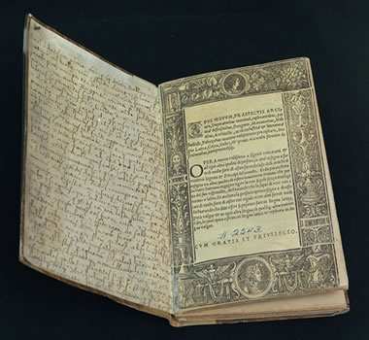
最早有關密碼的書 (1920)
Source: http://www.nsa.gov/museum/

Slide 45
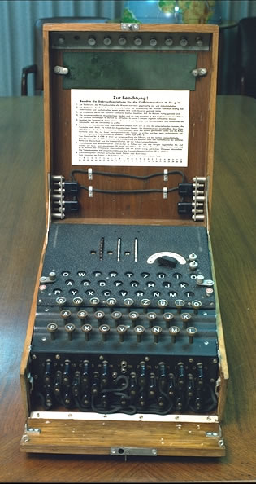
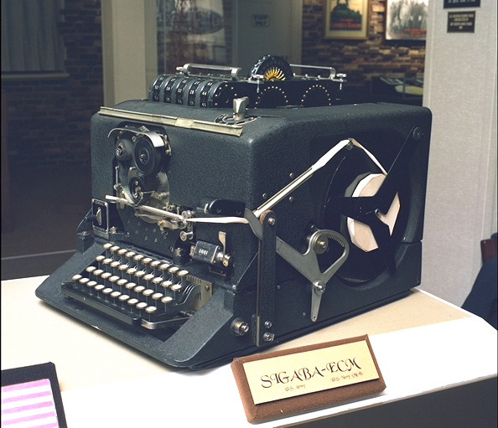
World War II
Enigma (德國)
Big machine (美國)
Source: http://www.nsa.gov/museum/

Slide 46
Three-Rotor Machine
Source: http://www.nsa.gov/museum/

Slide 47
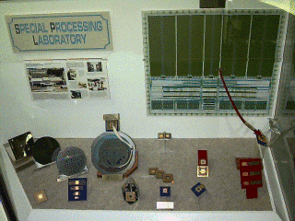
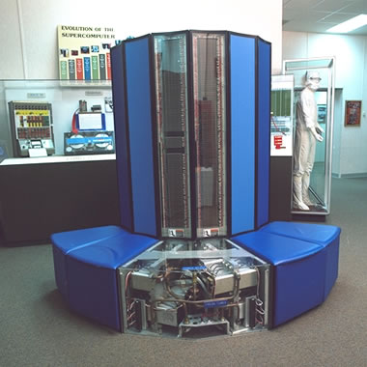
新時代
特殊IC
Supercomputer: Cray-XMP
Source: http://www.nsa.gov/museum/

Slide 48
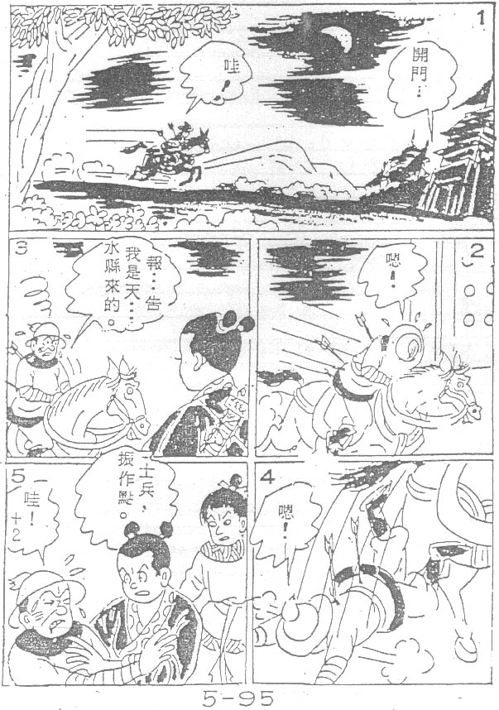
諸葛四郎大鬥雙假面
蠻兵
蠻兵
四郎
天水縣
蠻兵
蠻兵
士兵
龍鳳城 四郎
資料來源: 葉宏甲編著 “諸葛四郎全集: 大鬥雙假面,” 故鄉出版社, 1992.

Slide 49
Public Encryption: RSA 公開金鑰
e.g.
Painttext P = 13; public-key: e=11, r=15
Ciphertext C = modulo r
= modulo 15
= 1792160394037 modulo 15
= 7
Decryption P = modulo r
= modulo15
= 343 modulo 15
= 13
甲：e, r
乙：e, r, d
C =
P =

Slide 50
Public Encryption: RSA 公開金鑰 (cont.)
The scheme of : [Rivest78]
1. Choose, randomly, two distinct large primes p and q, and compute the product
r = p * q e.g. p=3, q=5, r=15
2. Choose, randomly, a large integer e, such that
gcd (e, (p-1)*(q-1) ) = 1
Note: any prime number greater than both p and q will do.
(p-1)*(q-1)= 2*4 = 8, e = 11
3. Take the decryption key, d, corresponding to e to be the unique "multiplicative inverse" of e, modulo (p-1)*(q-1);
i.e. d*e = 1, modulo(p-1)*(q- 1)
Note: The algorithm for computing d is straight forward.
d*11=1, mod 8, ==> d=3

Slide 51
Public Encryption: RSA 公開金鑰 (cont.)
Exercise: Suppose we have r = 2773, e = 17, try to find d = ?
Answer:
1. 50*50 = 2500 ~ 2773
2. 47*53 2773
3. 47*59 = 2773 so p = 47, q = 59
4. (p-1)(q-1) = 2668
5. d*17 = 1, modulo (p-1)*(q-1)
=> d*17 = 1, modulo 2668
d = 1: 17 + 2667 2668 x
d = 2: 4 + 2667 2668 x
d = 157: (157*17) / (2668) = 2
r: 50 digits => 4 hrs 75 digits => 100 days 100 digits => 74 years 500 digits => 4*10^25 years
.
.
.

Slide 52
" Signed" Ciphertext
Algorithm ENCRYPT_FOR_A - for encryption message to be sent to A
Algorithm DECRYPT_FOR_A - inverse of ENCRYPT_FOR_A
Algorithm ENCRYPT_FOR_B - for encrypting message to be sent to B
Algorithm DECRYPT_FOR_B - ...
[A do] 1. P’= ENCRYPT_FOR_B(DECRYPT_FOR_A(P) )
[sent] 2. Sent P’ to B
[B do] 3. ENCRYPT_FOR_A (DECRYPT_FOR_B(P’) ) => P
A
B
P’
P
P

Slide 53
end of unit 14

